Slide 1
AI and the Job Market: Challenges and Opportunities
Team3
111318104 郭冠榮 112999402 Kumaravel Sara
111C71008 何哲平 112C71002 李沛誼
112368006 崔士豪 112368103 湯承霖

Slide 2
CONTENTS
01
02
03
Introduction
Automation Challenges
Professional Transformation
04
05
06
07
Future Occupations
Different Perspectives on Work and Skill Requirements
Roles of Government, Corporations, and Individuals
Conclusion

Slide 3
01
PROBLEM VS. SOLUTION
Here you could describe the topic of the section

Slide 4
02
PROBLEM VS. SOLUTION
Here you could describe the topic of the section

Slide 5
03
Mercury is the closest planet to the Sun and the smallest one in the Solar System—it’s only a bit larger than the Moon. The planet’s name has nothing to do with the liquid metal

Slide 6
OUR COMPANY
04
Mercury is the closest planet to the Sun and the smallest one in the Solar System—it’s only a bit larger than the Moon

Slide 7
05
Mercury is the closest planet to the Sun and the smallest one in the Solar System—it’s only a bit larger than the Moon. The planet’s name has nothing to do with the liquid metal

Slide 8
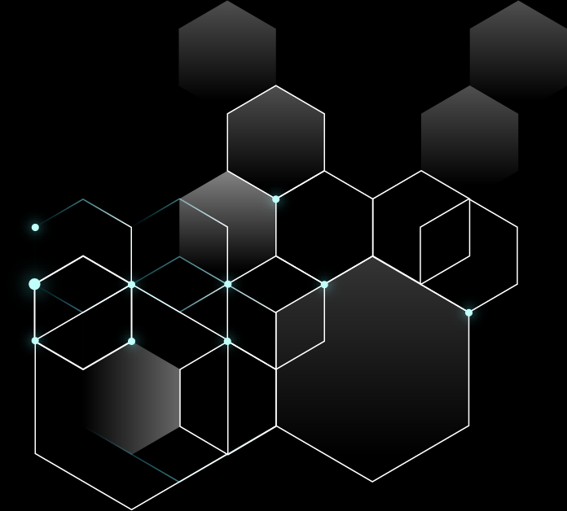
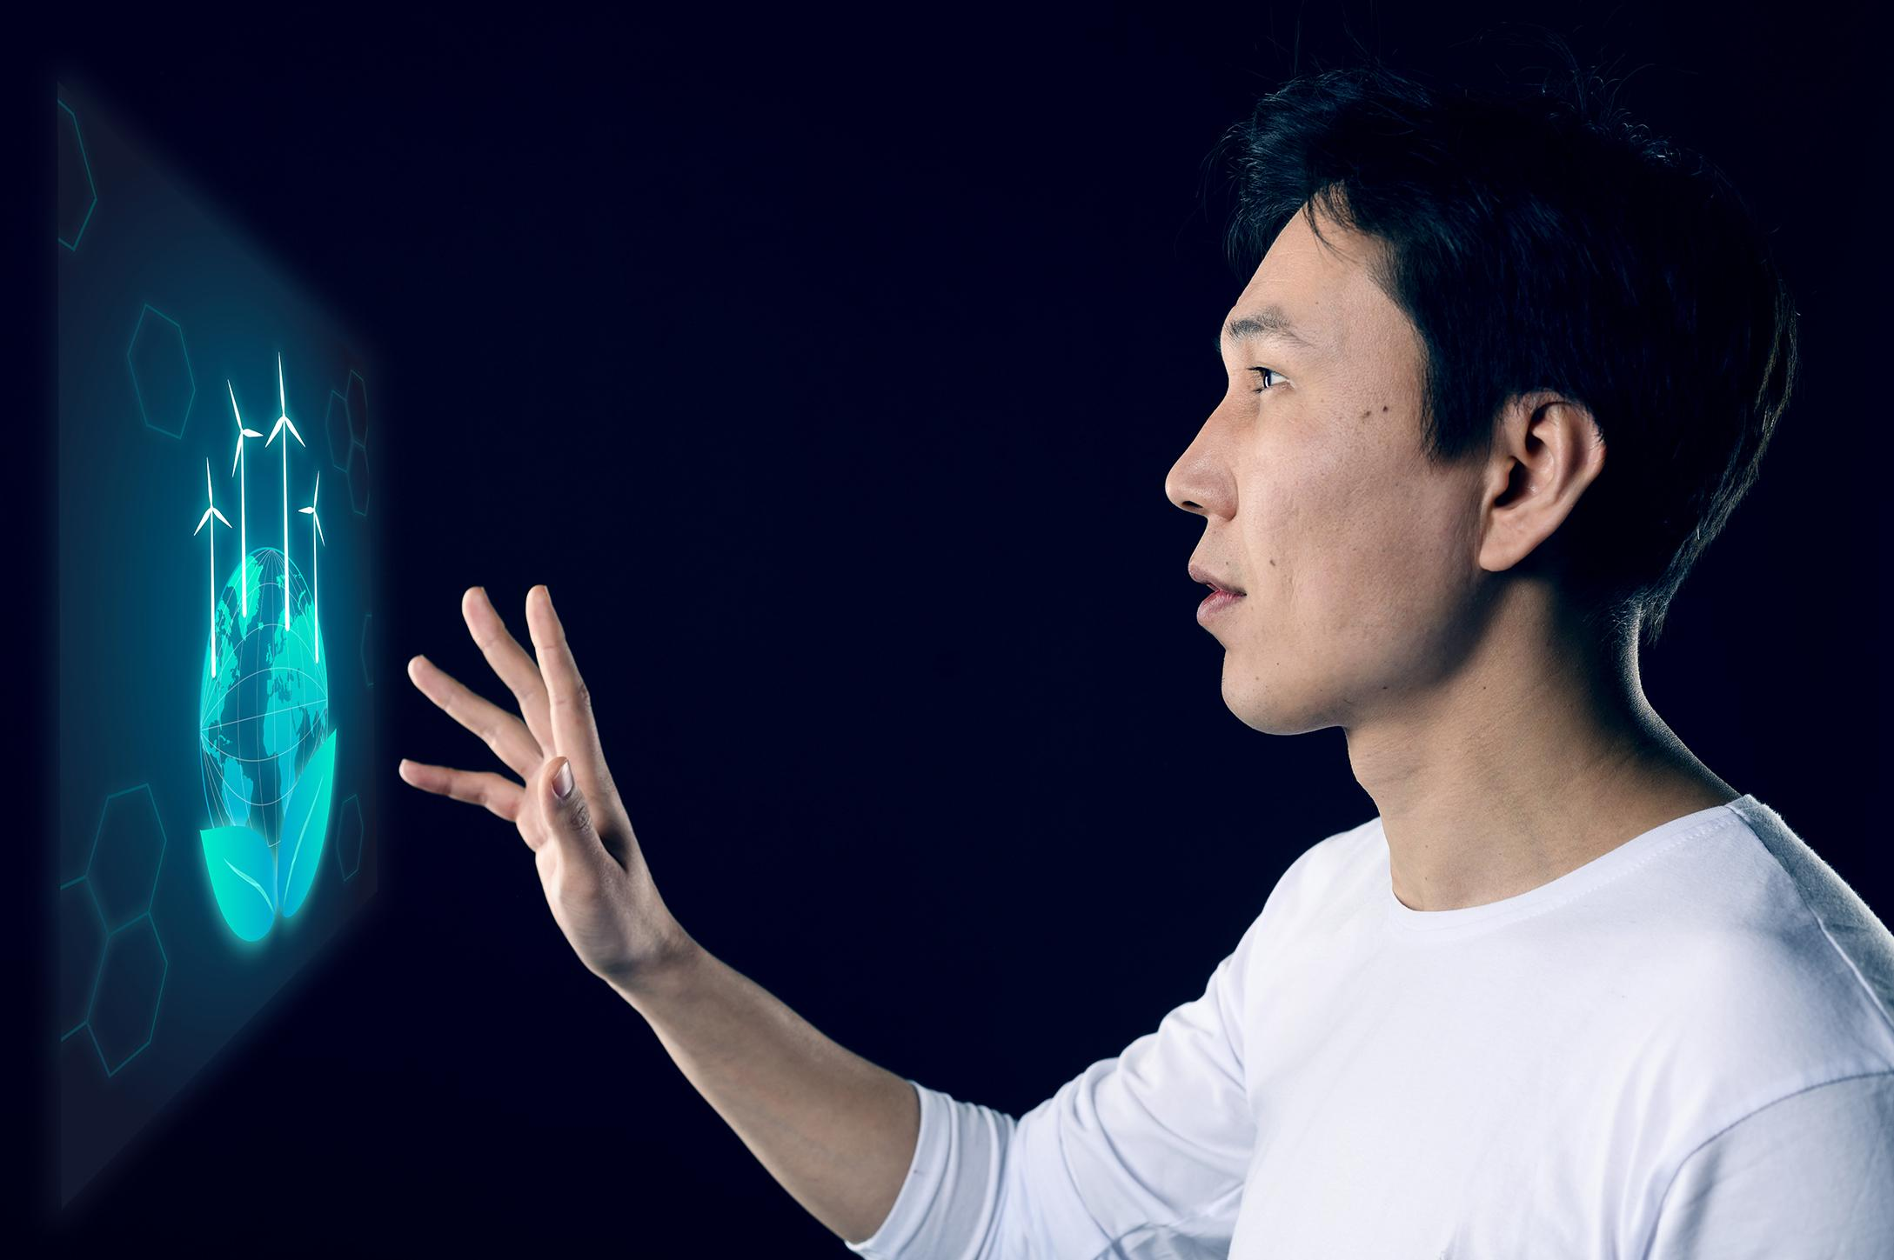
06
Mercury is the closest planet to the Sun and the smallest one in the Solar System—it’s only a bit larger than the Moon. The planet’s name has nothing to do with the liquid metal

Slide 9
07
Venus has a beautiful name and is the second planet from the Sun. It’s terribly hot—even hotter than Mercury

Slide 10
OUR TEAM
JENNA DOE
JOHN PATTERSON
HELENA JAMES
Here you could describe who this person is
Here you could describe who this person is
Here you could describe who this person is

Slide 11
INTRODUCTION
Mercury is the closest planet to the Sun and the smallest one in the Solar System—it’s only a bit larger than the Moon. The planet’s name has nothing to do with the liquid metal

Slide 12
INTRODUCTION
Mercury is the closest planet to the Sun and the smallest one in the Solar System—it’s only a bit larger than the Moon. The planet’s name has nothing to do with the liquid metal

Slide 13

WHOA!
It could be the part of the presentation where you can introduce yourself, write your email…

Slide 14
OUR TEAM
JENNA DOE
JOHN PATTERSON
HELENA JAMES
Here you could describe who this person is
Here you could describe who this person is
Here you could describe who this person is

Slide 15
REVIEWING IS GOOD IDEA
MERCURY
MARS
VENUS
JUPITER
SATURN
NEPTUNE
Mercury is the closest planet to the Sun
Despite being red, Mars is a cold place
Venus has a beautiful name, but it’s hot
It’s the biggest planet in the Solar System
Saturn is the ringed one and a gas giant
Neptune is the farthest planet from the Sun

Slide 16
COMPETITIVE ADVANTAGE
THEM
US
Mercury is the closest planet to the Sun and the smallest one of them all
Venus has a beautiful name and is the second planet from the Sun

Slide 17
THEM
COMPETITIVE ADVANTAGE
US
Mercury is the closest planet to the Sun and the smallest one in the Solar System—it’s only a bit larger than the Moon
Venus has a beautiful name and is the second planet from the Sun. It’s terribly hot—even hotter than Mercury

Slide 18
SOLUTION
Venus has a beautiful name and is the second planet from the Sun. It’s terribly hot—even hotter than Mercury

Slide 19
SWOT ANALYSIS
S
W
O
T
STRENGTHS
WEAKNESSES
OPPORTUNITIES
THREATS
Jupiter is the biggest planet in the Solar System
Venus has a beautiful name, but it’s hot
Neptune is the farthest planet from the Sun
Mercury is the smallest planet of them all

Slide 20
SWOT ANALYSIS
WEAKNESSES
THREATS
S
Venus has a beautiful name, but it’s hot
O
Mercury is the smallest planet of them all
w
T
STRENGTHS
OPPORTUNITIES
Jupiter is the biggest planet in the Solar System
Neptune is the furthest planet from the Sun

Slide 21
SWOT ANALYSIS
S
W
O
T
STRENGTHS
WEAKNESSES
OPPORTUNITIES
THREATS
Jupiter is the biggest planet in the Solar System
Venus has a beautiful name, but it’s hot
Neptune is the furthest planet from the Sun
Mercury is the smallest planet of them all

Slide 22

A PICTURE IS WORTH A THOUSAND WORDS

Slide 23
PRODUCT OVERVIEW
VENUS
NEPTUNE
Venus has a beautiful name
Neptune is the farthest planet
MERCURY
JUPITER
Mercury is the smallest planet
Jupiter is the biggest planet

Slide 24
PRODUCT OVERVIEW
MERCURY
NEPTUNE
JUPITER
VENUS
Mercury is the smallest planet
Neptune is the farthest planet
Jupiter is the biggest planet
Venus has a beautiful name

Slide 25
PLANS
You can explain your
product or your service
You can explain your
product or your service
You can explain your
product or your service
BASIC
PRO
PREMIUM

Slide 26
PLANS
BASIC
PRO
PREMIUM
You can explain your
product or your service
You can explain your
product or your service
You can explain your
product or your service
150
200
250

Slide 27
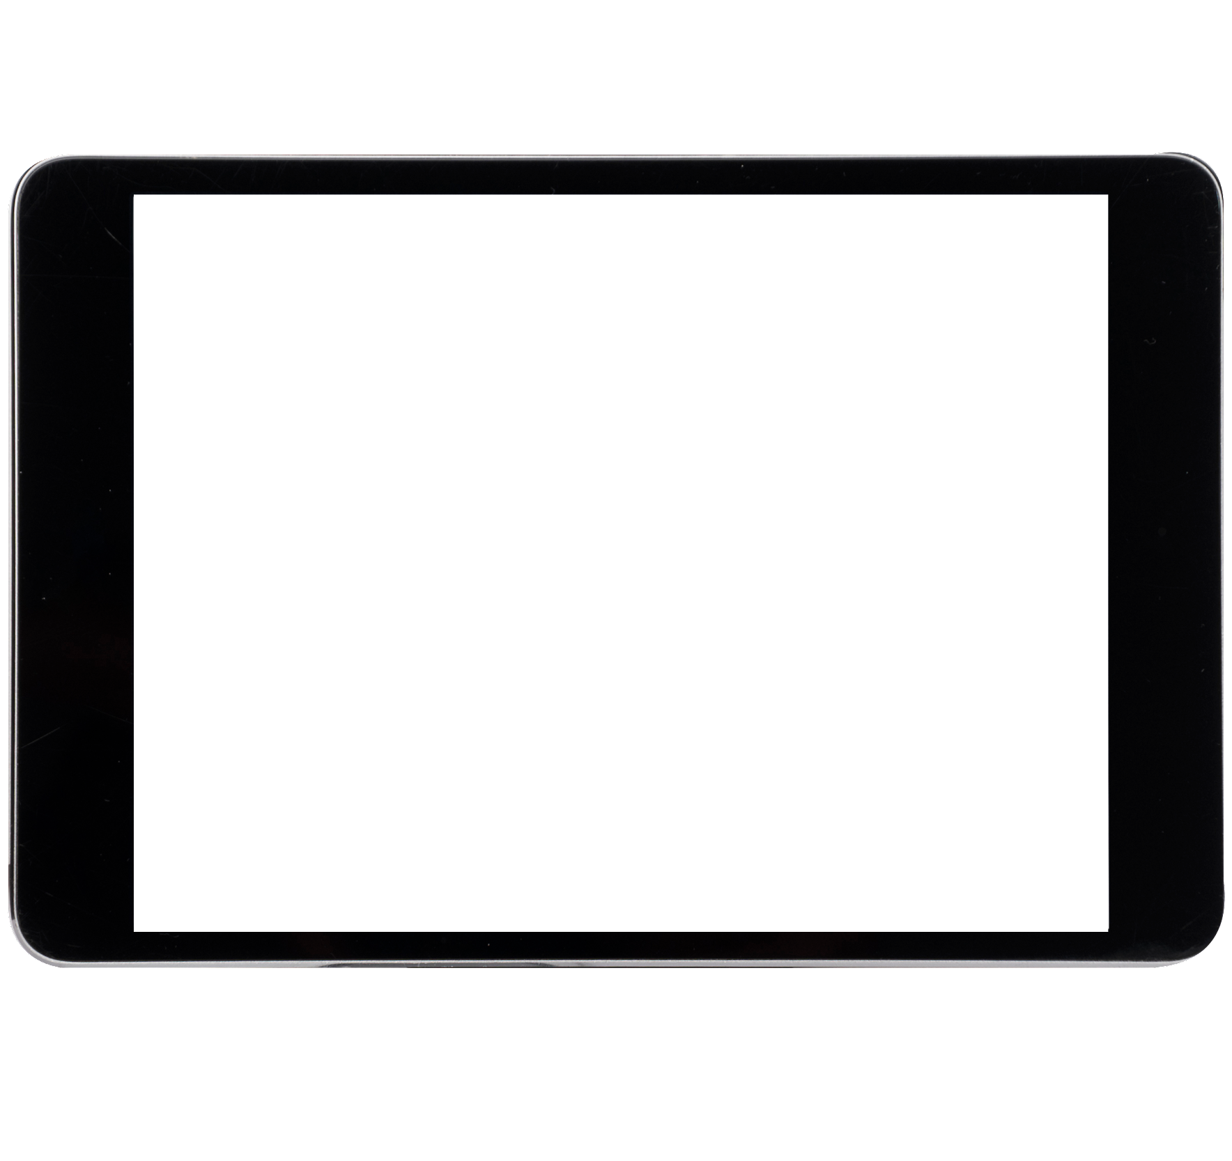
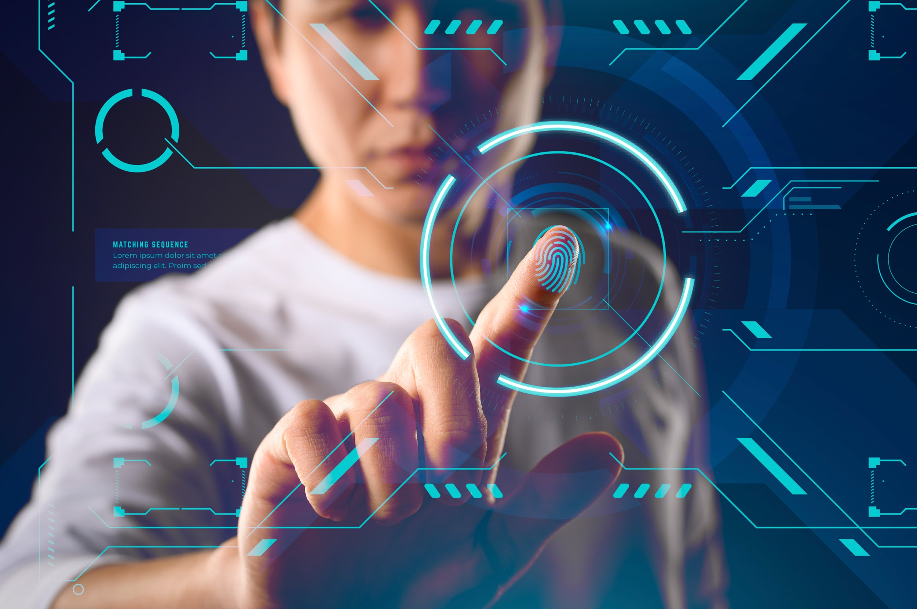
DEMO
Insert your multimedia content here Images reveal large amounts of data

Slide 28
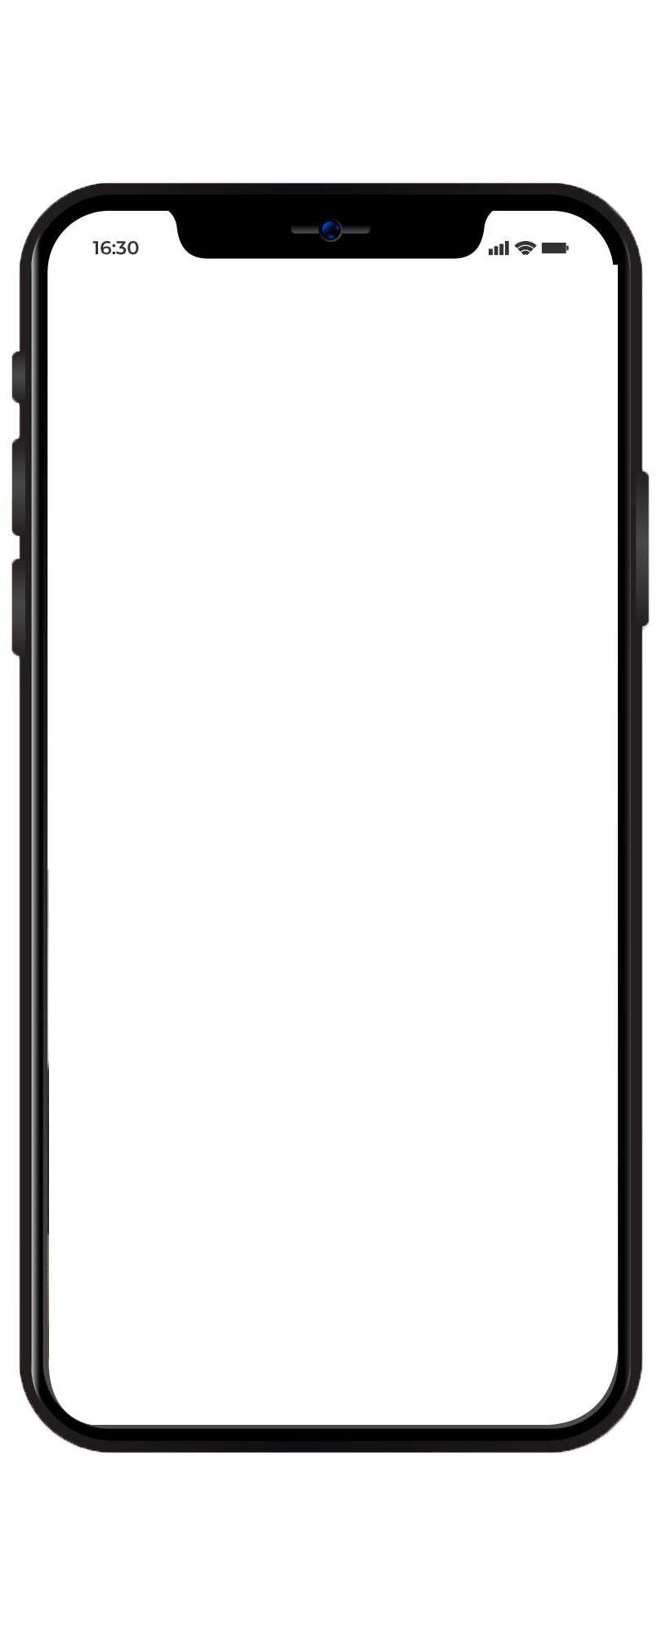
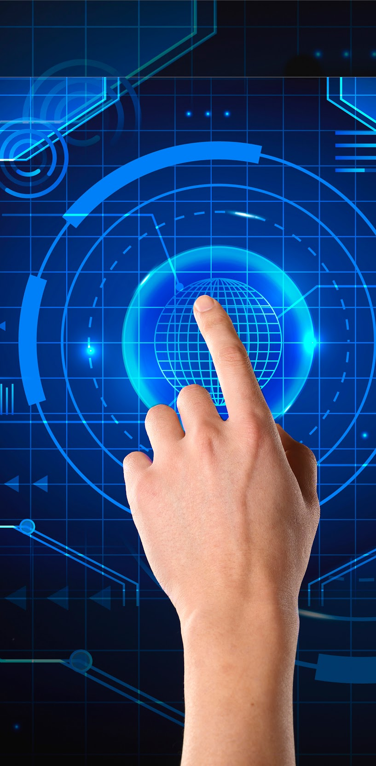
DEMO
Insert your multimedia content here Images reveal large amounts of data

Slide 29
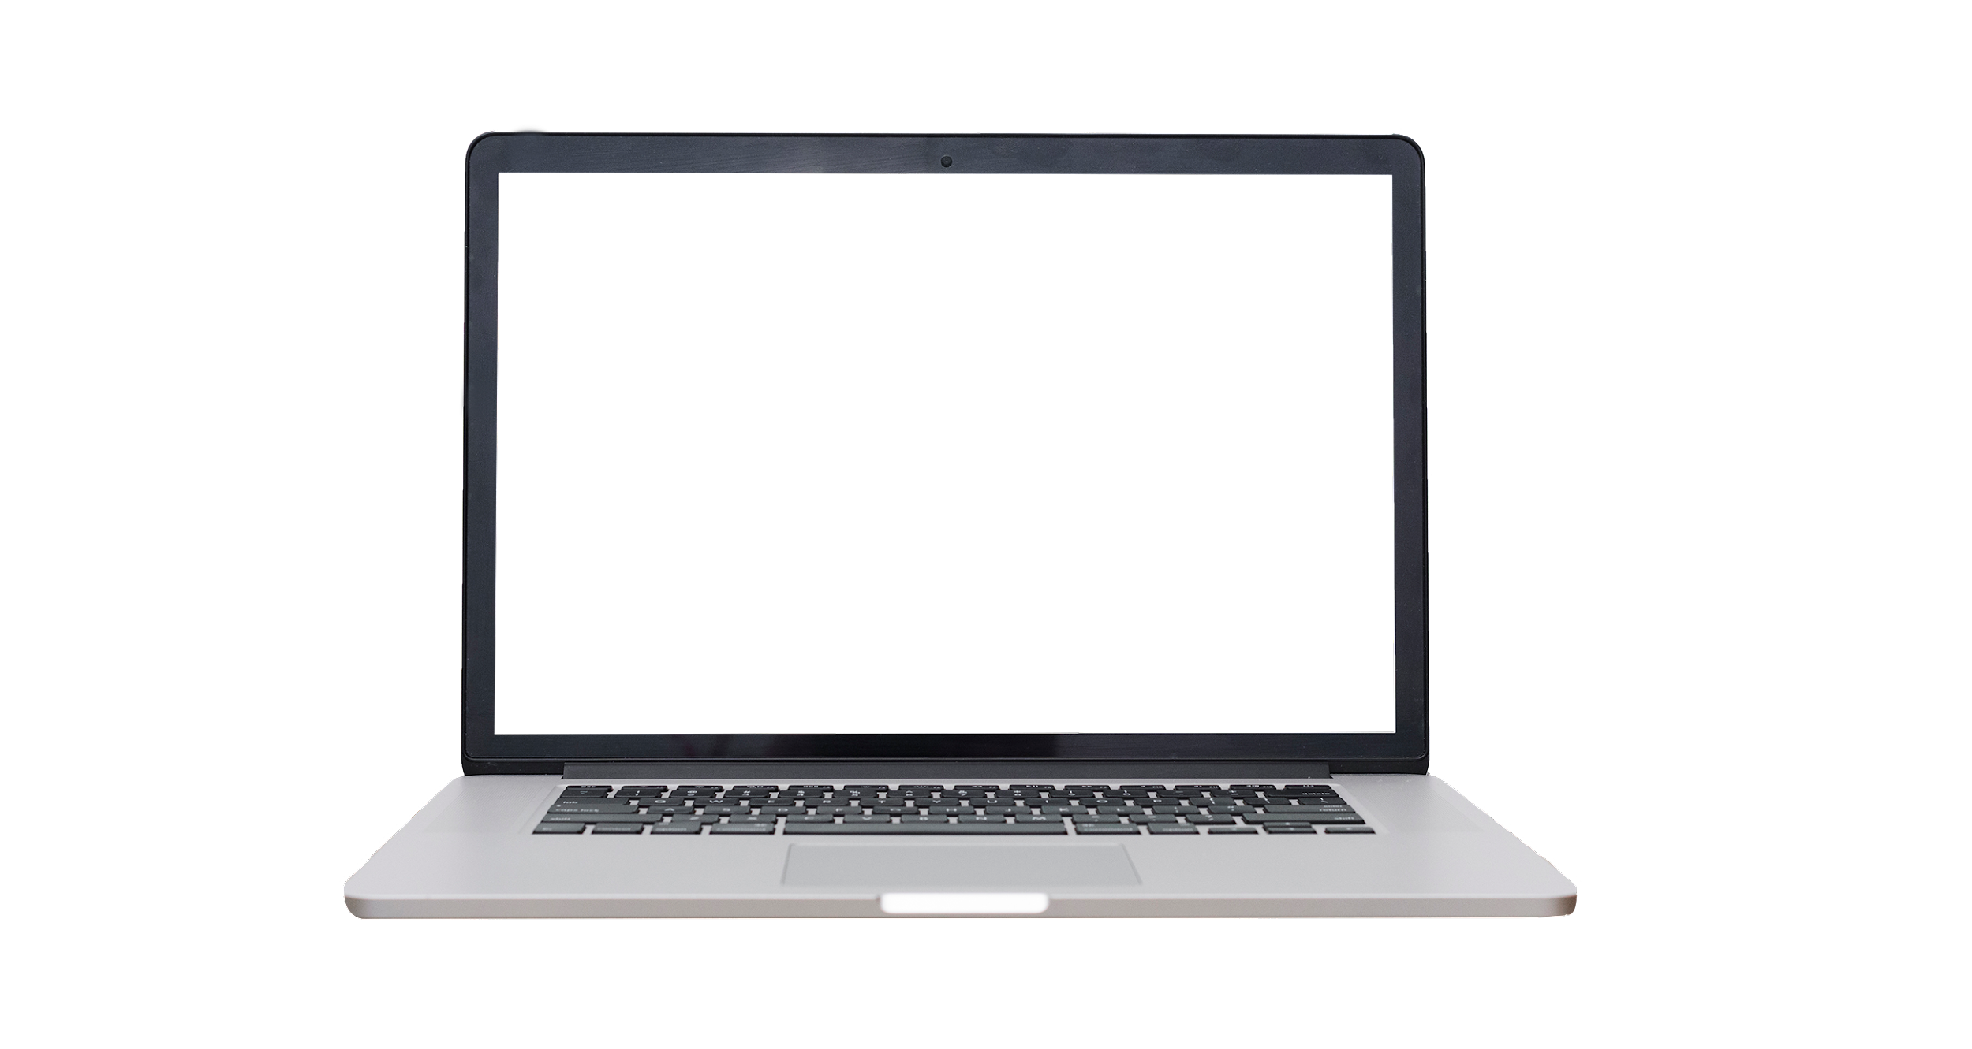
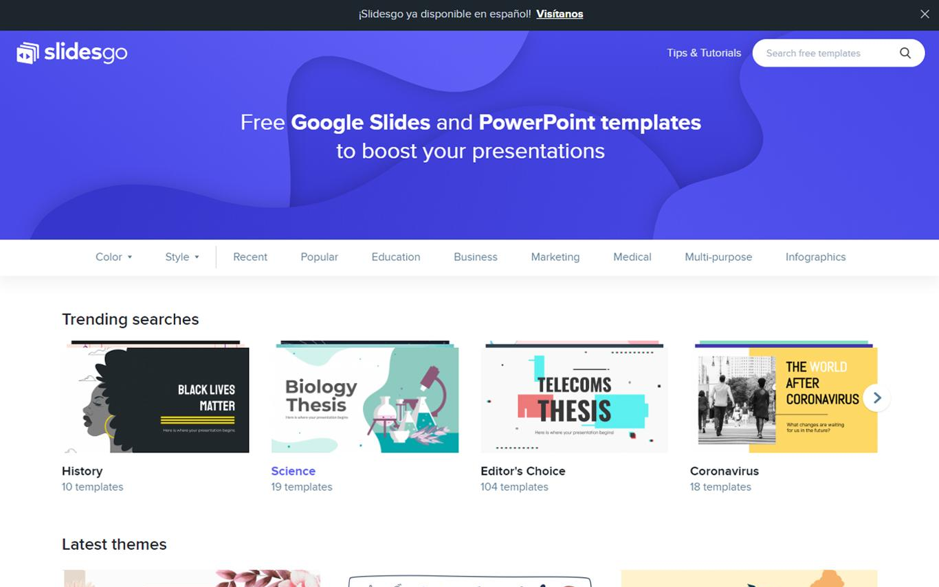
DEMO
Insert your multimedia content here Images reveal large amounts of data

Slide 30

TRACTION
$150,000
$1,000
12,000
2,200
15
Revenue in 2017-2018
Average user savings
Registered businesses
Daily number of users
Total app downloads
To modify this graph, click on it, follow the link, change the data and paste the new graph here

Slide 31
TRACTION
$150,000
2,200
140,000
12,000
Gross revenue for download concept
Registered businesses
only in the West Coast
Daily number of users
connected to our app
Total app downloads
in just one week
To modify this graph, click on it, follow the link, change the data and paste the new graph here, replacing this one

Slide 32
CASE STUDY
CHALLENGE
Neptune is the farthest planet from the Sun
SOLUTION
Despite being red, Mars is a very cold place
RESULTS
Venus has a beautiful name, but it’s terribly hot

Slide 33
CASE STUDY
CHALLENGE
RESULTS
Venus has a beautiful name, but it’s terribly hot
Neptune is the farthest planet from the Sun
SOLUTION
Despite being red, Mars is a cold place

Slide 34
REVIEWS
CLIENT 1
CLIENT 3
HELENA JAMES, 21
CLIENT 2
JOHN PATTERSON, 33
“It’s the biggest planet in the Solar System”
“Saturn is composed mostly of hydrogen and helium”
JENNA DOE, 52
“Jupiter is the biggest planet in the Solar System”

Slide 35



REVIEWS
HELENA JAMES, 21
JOHN DOE, 52
JOHN PATTERSON, 33
“It’s the biggest planet in the Solar System”
“Jupiter is the biggest planet in the Solar System”
“Venus is the second planet from the Sun”

Slide 36
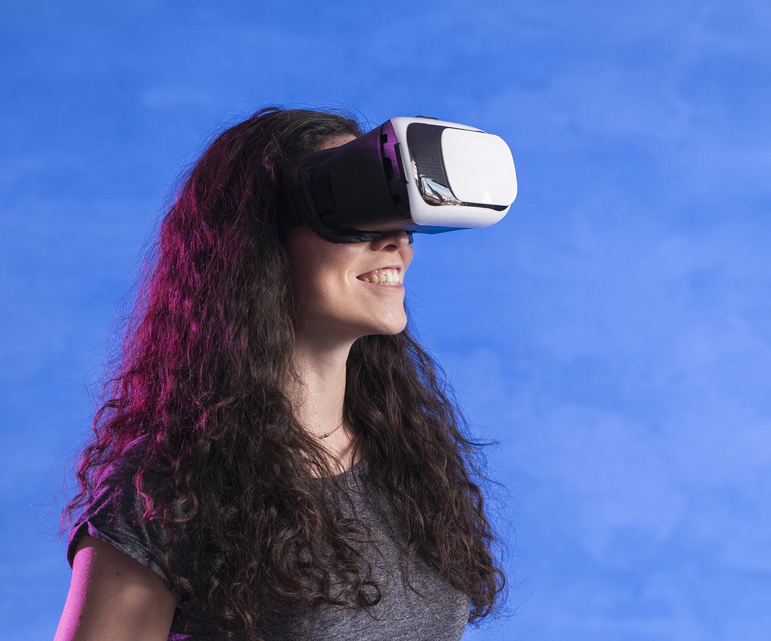
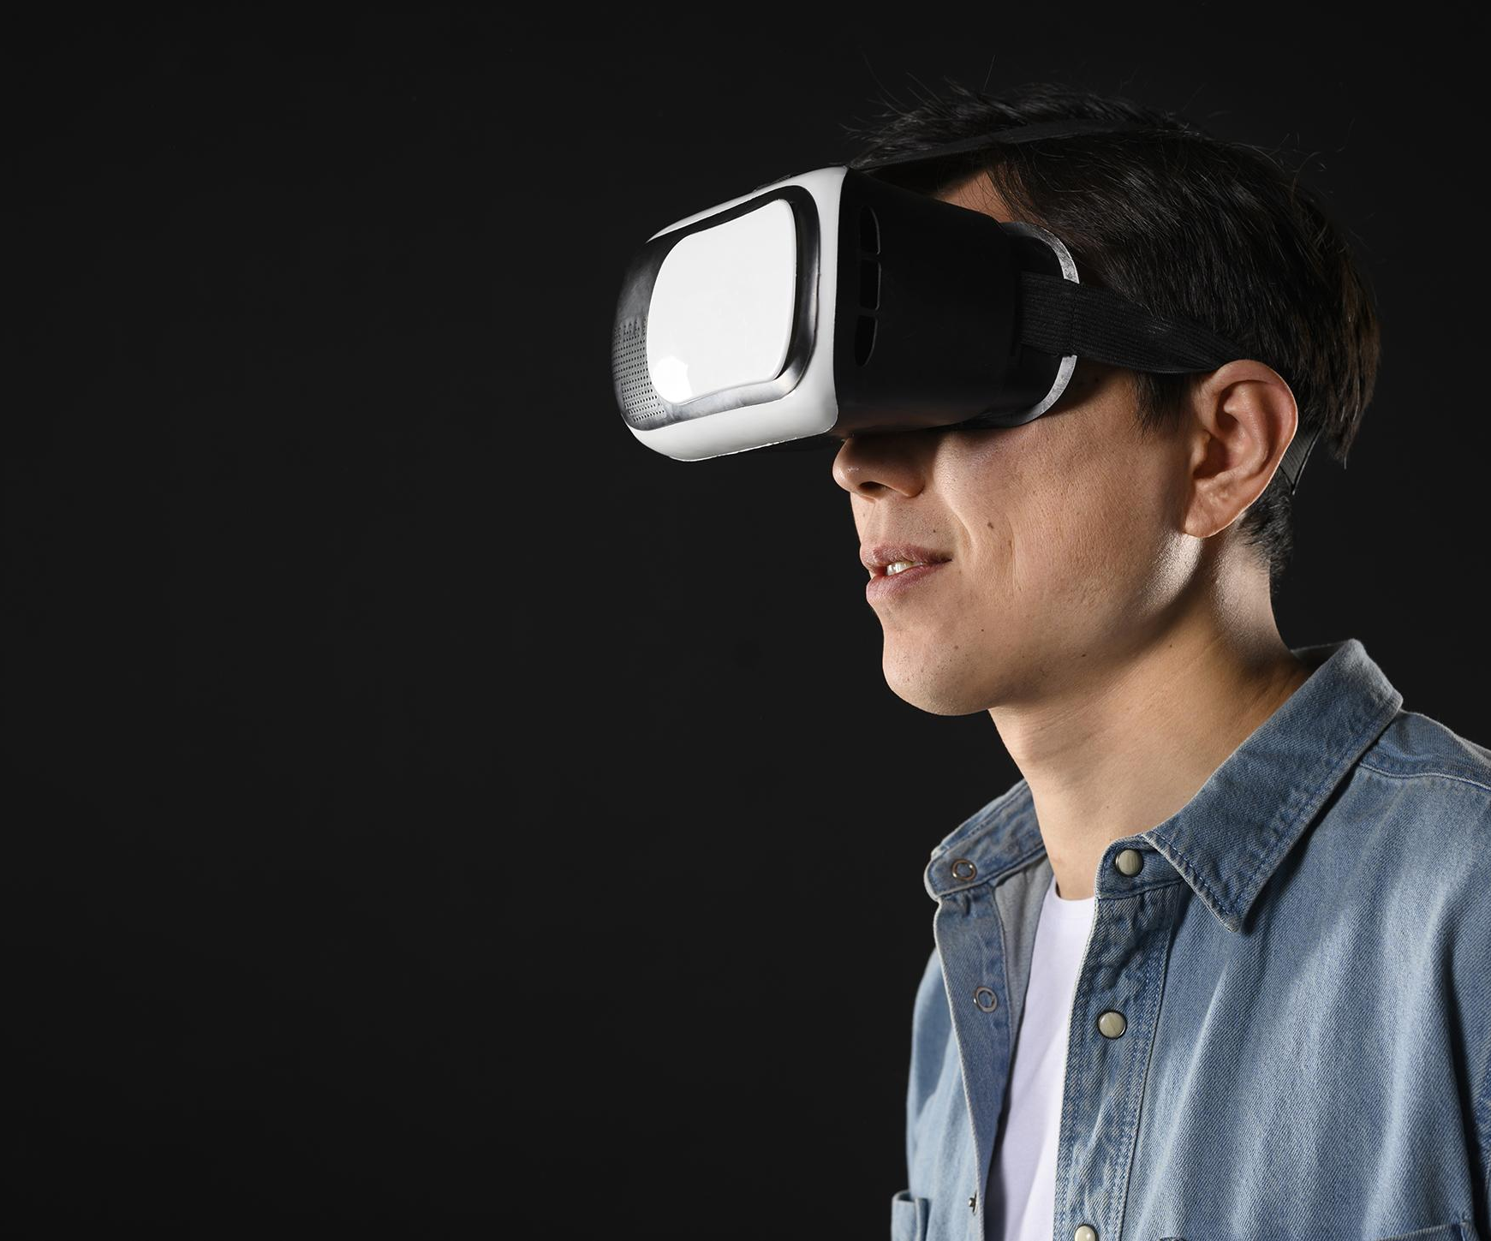
OUR TEAM
JANE DOE
JOHN DOE
You can replace the
image on the screen
with your own
You can replace the
image on the screen
with your own

Slide 37
AWARDS
MERCURY
VENUS
JUPITER
MARS
Here you could talk about this achievement
Here you could talk about this achievement
Here you could talk about this achievement
Here you could talk about this achievement

Slide 38
AWARDS
MERCURY
JUPITER
VENUS
MARS
Here you could talk about this achievement
Here you could talk about this achievement
Here you could talk about this achievement
Here you could talk about this achievement

Slide 39
AWARDS
2017
2018
2019
2020
Here you could talk about this achievement
Here you could talk about this achievement
Here you could talk about this achievement
Here you could talk about this achievement

Slide 40
MARKET SIZE
45%
18%
30%
VENUS
Venus has a beautiful name, but it’s hot
MARS
MERCURY
Jupiter is the biggest planet of them all
Neptune is the farthest planet from the Sun

Slide 41
MARKET SIZE
50
VENUS
30
MERCURY
25
JUPITER
15
SATURN
Jupiter is the biggest planet
Venus has a beautiful name
Neptune is the farthest planet
Mercury is the smallest one

Slide 42
MARKET SIZE
75%
40%
30%
15%
VENUS
MERCURY
SATURN
MARS
Jupiter is the biggest planet
Venus has a beautiful name
Neptune is the furthest planet
Mercury is the smallest one

Slide 43
TARGET
40%
60%
$50.00
GENDER
AVERAGE SPEND PER CUSTOMER
AGE
INTEREST
20-35
40%
READING
WRITING
36-55
60%
TRAVELING

Slide 44
TARGET
GENDER
INTEREST
40%
60%
Venus is the second planet from the Sun”
READING
AVERAGE SPEND PER CUSTOMER
Jupiter is the biggest planet of them all
WRITING
$50.00
Neptune is the farthest planet from the Sun
TRAVELING

Slide 45
4,498,300,000
Big numbers catch your audience’s attention

Slide 46
4,498,300
Big numbers catch your audience’s attention

Slide 47
COMPETITORS
NEPTUNE
MARS
MERCURY
Neptune is the farthest planet
Mars is a very cold place
Mercury is the smallest planet

Slide 48
COMPETITORS
1
2
3
NEPTUNE
MARS
MERCURY
Neptune is the farthest planet
Despite being red, Mars is cold
Mercury is the smallest planet

Slide 49
BUSINESS MODEL
MARKETING
TRAINING
ASSESSMENT
TECHNOLOGY
Jupiter is the biggest planet
Venus has a beautiful name
Neptune is the farthest planet
Mercury is the smallest one

Slide 50
BUSINESS MODEL
ASSESSMENT
TRAINING
MARKETING
Neptune is the farthest planet
Venus has a beautiful name
Despite being red, Mars is cold
PERCENTAGE
TECHNOLOGY
Mercury is the smallest one
Jupiter is the biggest planet

Slide 51
TIMING
DAY 1
Jupiter is the biggest planet
DAY 3
DAY 2
Despite being red, Mars is cold
Venus has a beautiful name
DAY 4
DAY 5
Mercury is the smallest planet
Neptune is very far away

Slide 52
TIMING
MARS
VENUS
Despite being red, Mars is very cold
DAY 1
DAY 2
Venus has a beautiful name
MERCURY
NEPTUNE
Mercury is the smallest planet
DAY 3
DAY 4
Neptune is the fourth-largest

Slide 53
TIMING
DAY 1
DAY 2
DAY 3
DAY 4
Mercury is the closest planet to the Sun and the smallest one
Venus has a beautiful name and is the second planet
Despite being red, Mars is actually a very cold place
Neptune is the fourth-largest planet in the Solar System

Slide 54
PREDICTED GROWTH
Jupiter is a gas giant and the biggest planet of them all
Neptune is the farthest planet from the Sun
Venus has a beautiful name, but it’s terribly hot
Despite being red, Mars is actually a cold place

Slide 55
PREDICTED GROWTH
JUPITER
Jupiter is a gas giant and the biggest planet
VENUS
Venus has a beautiful name, but it’s hot
NEPTUNE
Neptune is the farthest planet from the Sun
MARS
Despite being red, Mars is a cold place

Slide 56

INVESTMENT
40%
30%
MERCURY
JUPITER
Mercury is the smallest planet of them all
Jupiter is the biggest planet of them all
20%
10%
VENUS
SATURN
Venus is the second planet from the Sun
Saturn is a gas giant and has rings
To modify this graph, click on it, follow the link, change the data and paste the new graph here

